Slide 1

TheraDog
WHERE DOGS GET JOBS

Slide 2
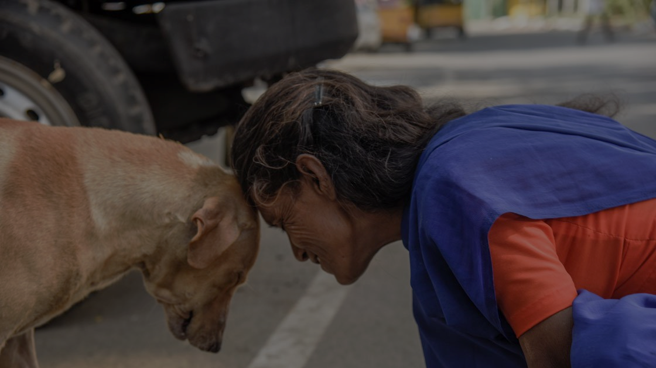
MENTAL
HEALTH
problems.
STRAY
DOGS

Slide 3
MENTAL
HEALTH
solution.
STRAY
DOGS

Slide 4


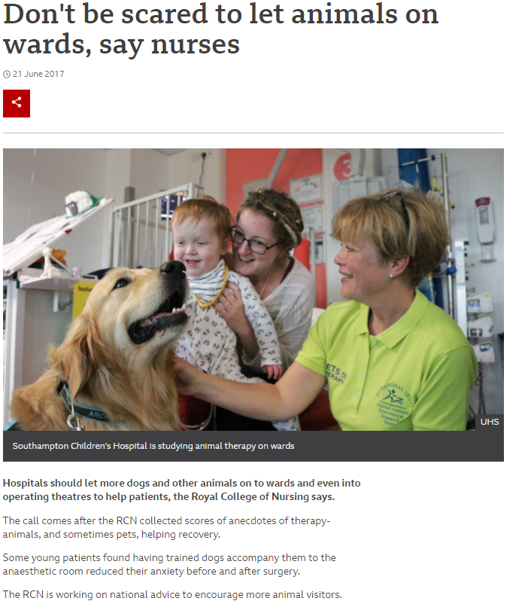

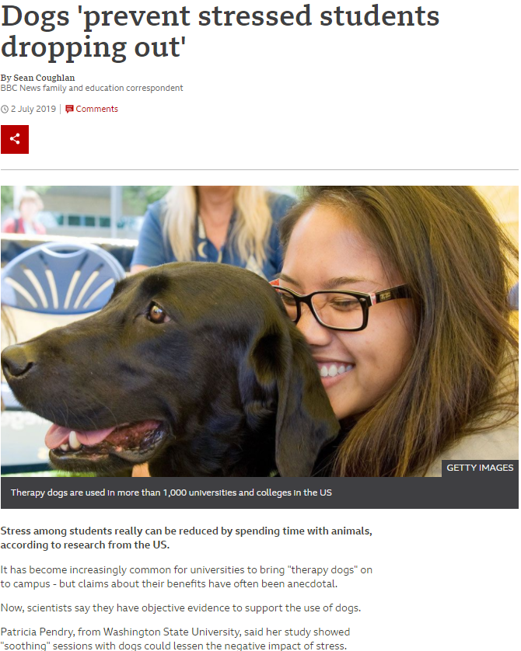




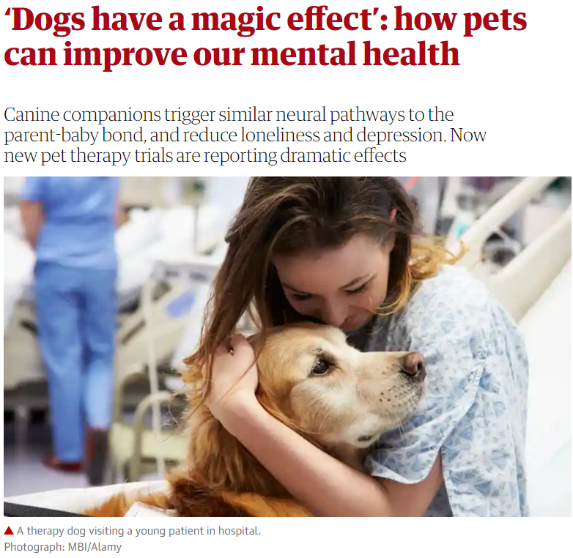

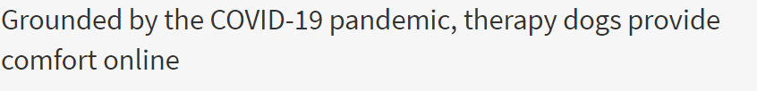
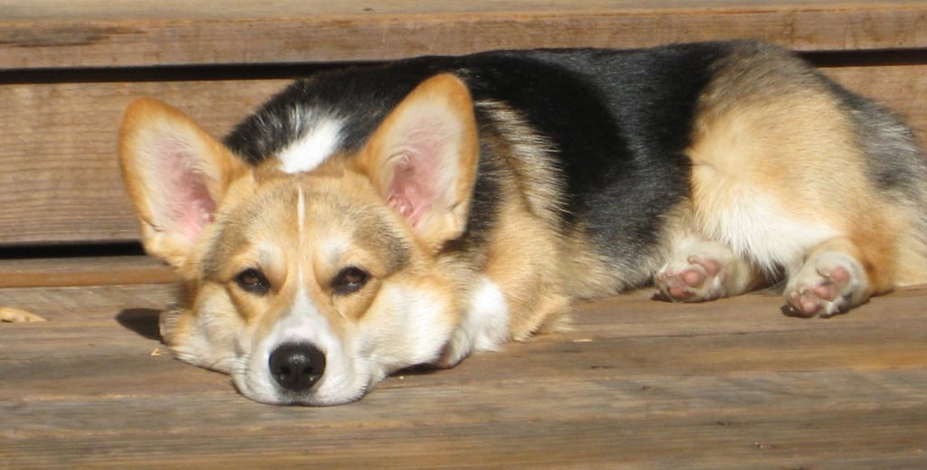



Slide 5



our clientele.
WORKING PROFESSIONALS
LONE SENIOR CITIZENS
MENTAL HEALTH PATIENTS

Slide 6
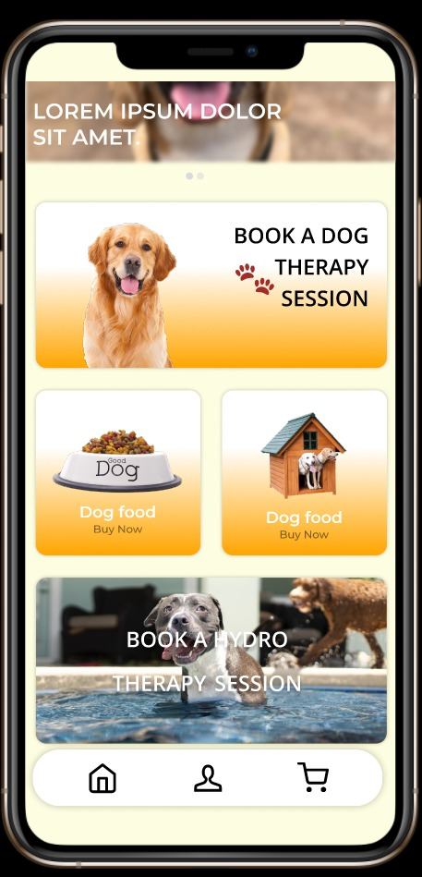
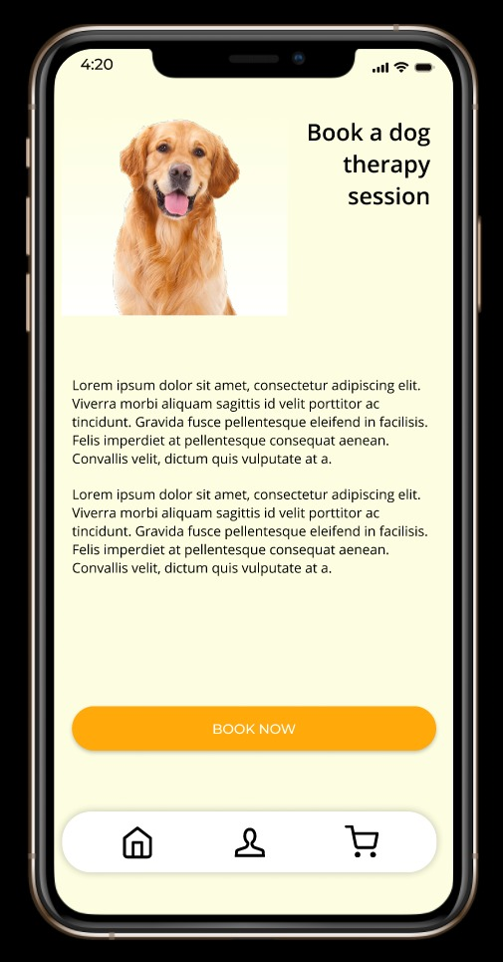
our app.

Slide 7



THE BUSINESS DESIGN
REVENUE
SPENDINGS
MARKETING

Slide 8
revenue
THE USP
DOG THERAPY
HYDRO
THERAPY
PET FRIENDLY
CAFÉ
DOG TREATS
STORE
DOG BOARDING FACILITIES
DOG WALKER SERVICE
PERSONAL PET
TRAINING
DOG PLAY
DATES

Slide 9
costs
HAPPY CENTRES
HIRING TRAINERS
DOG’S WELL BEING
SHELTER HOMES

Slide 10
marketing
WORD OF MOUTH
MEDIA MARKETING
TWO-WAY NETWORKING WITH DOG WALKERS, PET SITTERS, PET BOUTIQUES, AND VETERINARY CLINICS

Slide 11










SERVICES FOR DOGS WITH POOR LIVING CONDITIONS
TheraDog
SERVICES FOR PEOPLE WITH MENTAL HEALTH CONDITIONS
Notes:
Competition Review

Slide 12

G R O W T H
MULTI-CITY EXPANSION
TOP-DOWN SERVICE EXPANSION
MULTIPLE THERAPIES

Slide 13

Let the Dog Do the Job For You.
THANK YOU! - TEAM THERADOGS

